Slide 1
Dysrhythmias
DR MAZIN ABED HAZZA

Slide 2
Objectives
What are dysrhythmias.
How to diagnose types of supraventricular tachycardia.
Type of ventricular tachycardia.
Clinical impact of dysrhythmias

Slide 3
Mechanisim of arrythmias
Disorders of impulse formation.
Disorders of impulse conduction.

Slide 4
Mech. Of arrytmias
Disorders of impulse formaion
Disorders of impulse conduction
Derrengment of automaticity.
Trigerring activety:
Early afterdepolerizaion
Late after depoerization.
Reentery cycle

Slide 5
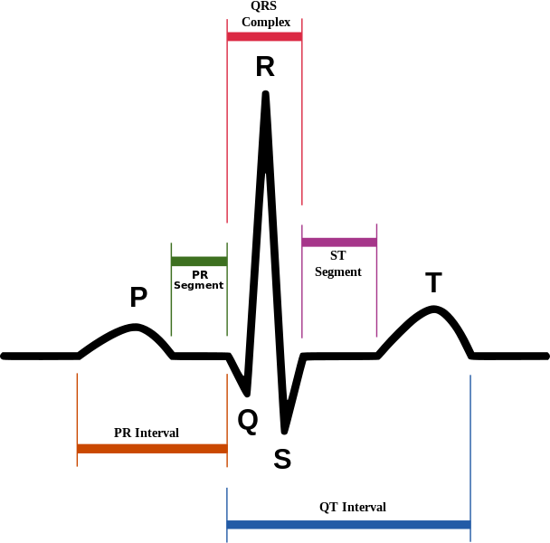
Dysrhythmia or Arrhythmia
Electrical activity of atrium and ventricles is correlated and organized
Electrical activity of the heart is correlated to hemodynamic activity
Atrial activity >>>> look at p wave
Ventricular activity >>>> look at QRS
A-V correlation >>>> look at relation of P and QRS

Slide 6
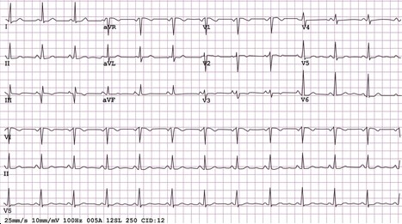

Slide 7
On diagnosing dysrhythmias
FISRT | Shape of P wave & QRS complex in all beats
SECOND | Relation of P wave to the QRS complex in all beats
THIRD | The heart rate >>> normally between 60 - 100 B/M
FOURTH | Rhythm of the P wave and QRS complex in all beats

Slide 8
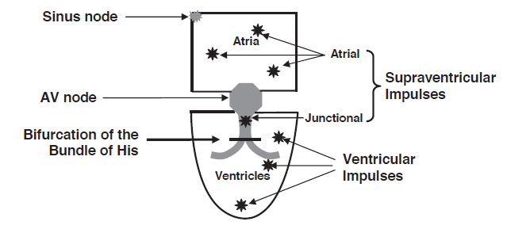

Slide 9
Supraventricular Dysrhythmias

Slide 10
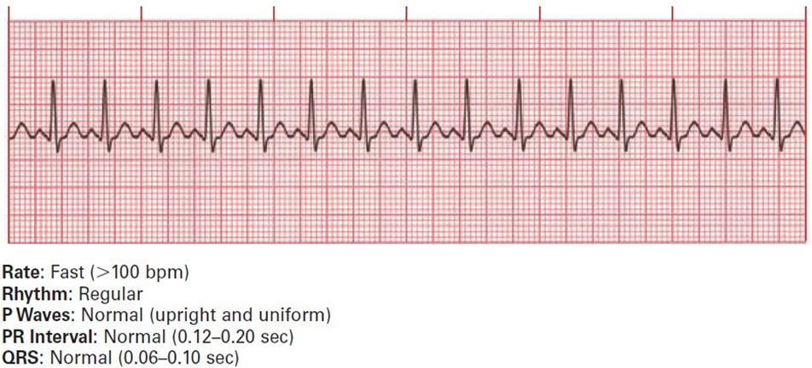
Abnormalities of the rate
Sinus Tachycardia
Causes:
Physiological: exercise, anxiety, coffee, stress
Diseases: Hyperthyroidism, fever, anemia.
Drugs: beta-agonist, Atropine, Actifed
Clinical features:
Treatment:

Slide 11
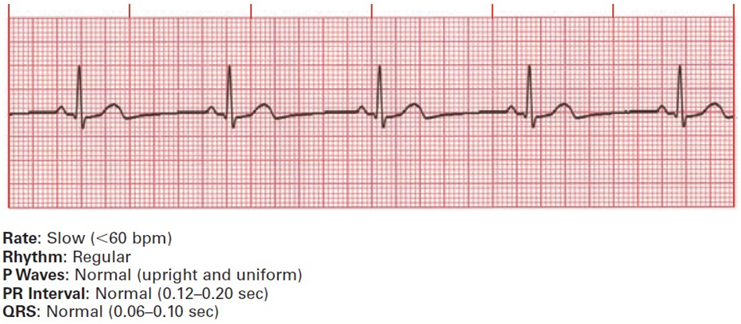
Abnormalities of the rate
Sinus Bradycardia
Causes:
Physiological: athletes, elderly, sleep.
Diseases: Hypothyroidism, ischemia, SSS.
Drugs: beta-agonist, Atropine, Actifed
Clinical features:
Treatment:

Slide 12
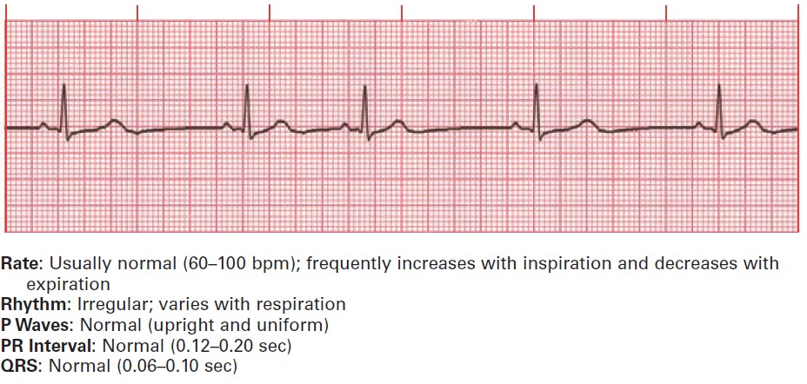
Abnormalities of the rhythm
Sinus arrhythmia
Cause:
Exaggeration of normal variation of PP intervals (> 10%) due to respiration
Clinical features:
Treatment:

Slide 13
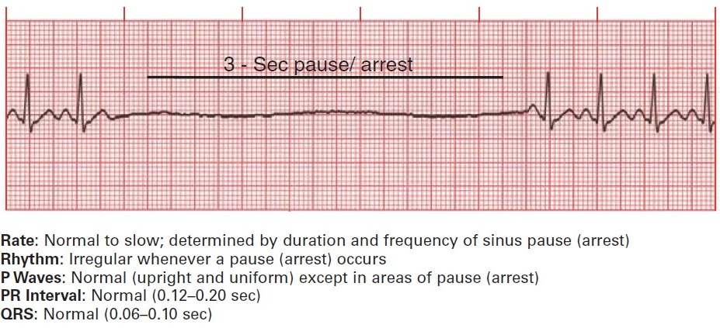
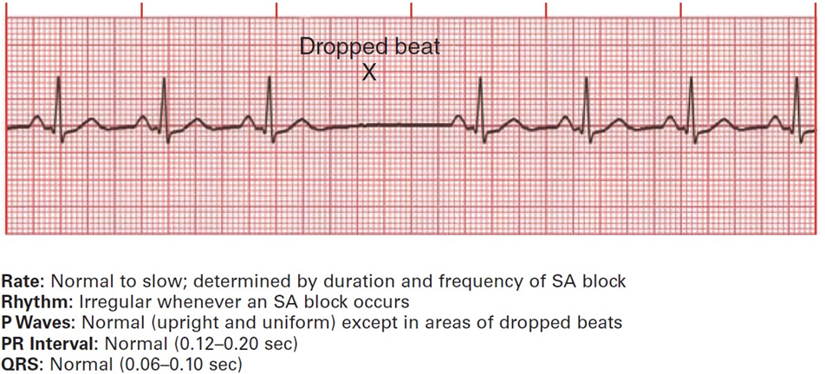
Sinus arrest and sinus exit block
Causes:
Clinical features:
Treatment:

Slide 14
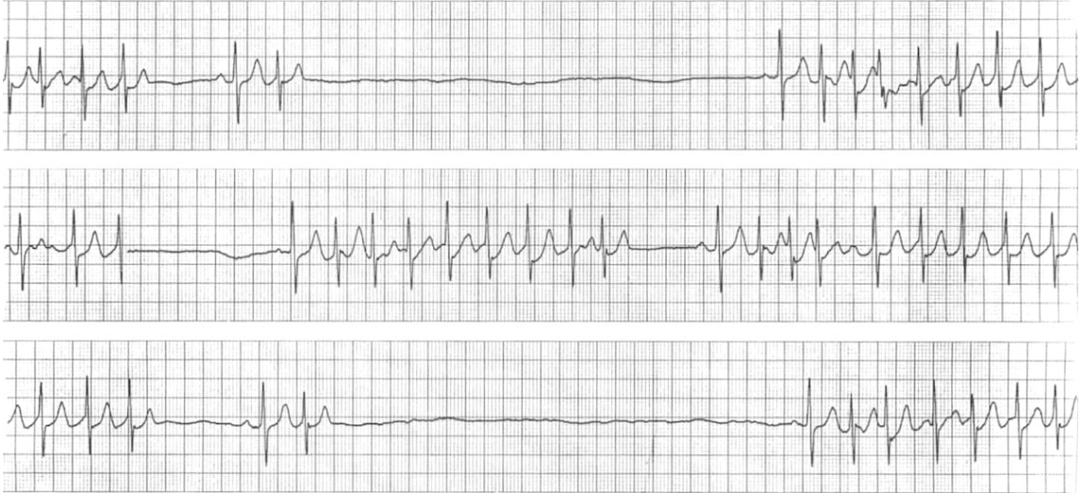
Sick sinus syndrome (SSS)
Causes:
Ischemia, degeneration, infiltration, metabolic
ECG’s Presentation:
Bradycardia, tachycardia, sinus arrest, exit block, atrial fibrillation

Slide 15
Clinical tip
Great correlation between electrical activity and mechanical activity of the heart
So, sinus block and arrest, bradycardia, tachycardia, and SSS can affect the blood (O2) delivery to the brain and other organs
Tiredness on exertion, dizziness, presyncope, and even syncope
Think of these arrhythmias even if the initial ECGs are normal
Ambulatory ECG monitoring ( Holter) can help

Slide 16
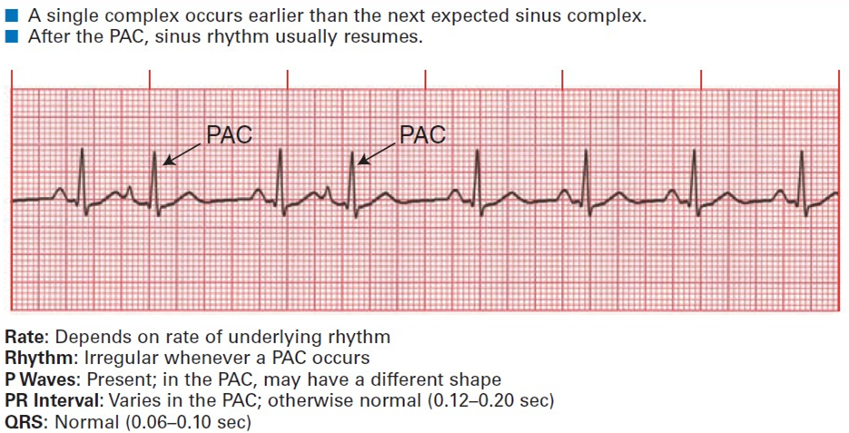
Premature atrial contractions

Slide 17
Tachycardia: a heart rate 100 beats per minute (bpm).
Supraventricular
Ventricular
Bifurcation of the bundle of His
Width of QRS complex
?
BUT
Presence of p wave

Slide 18
Supraventricular Tachycardia
Regular
Irregular
Supraventricular tachycardia (SVT)
Atrial fibrillation (AF)
Sinus tachycardia
Multifocal atrial tachycardia (MAT)
Atrial flutter
Atrial flutter
Multifocal atrial tachycardia (MAT)

Slide 19
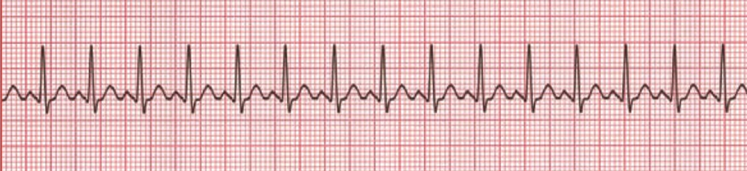
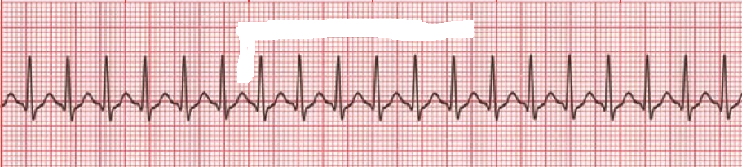
Supraventricular (regular)
Sinus tachycardia
Supraventricular tachycardia (SVT)
Similarities
Differences
Narrow QRS complex
Rate
Regular
Absence of p wave

Slide 20
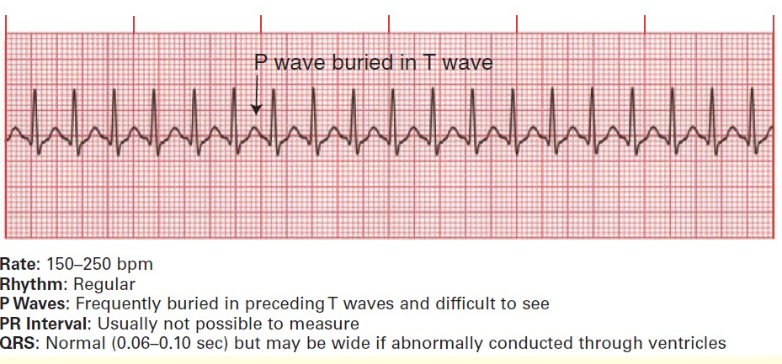
Supraventricular tachycardia (SVT)

Slide 21
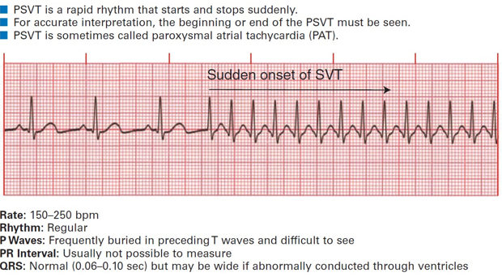
Paroxysmal Supraventricular tachycardia (SVT)
Causes of SVT:
May be related to anxiety, stress, caffeine, and nicotine.
IHD, Pul diseases
Clinical features:
Dizziness, palpitation, presyncope, and syncope
Treatment:

Slide 22
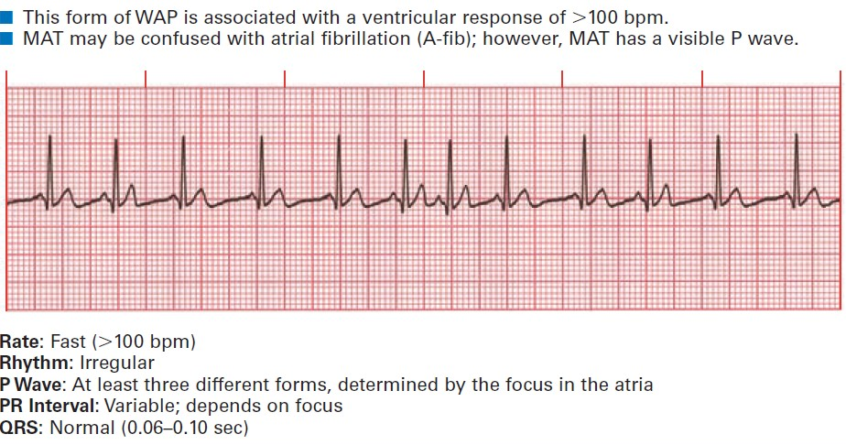
Supraventricular (irregular)
Multifocal atrial tachycardia (MAT)
Usually associated with Pulmonary diseases
DD: AF ( use of anticoagulation)

Slide 23
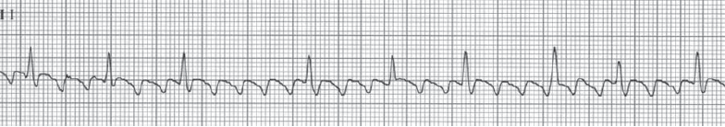
Rapid atrial rate 250-350 b/m.
Usually there is AV block (2:1, 3:1,4:1 etc.)
The atrial rate is regular, ventricular rate could be regular or irregular depending on the degree of block .
Very frequent P wave >>> saw teeth appearance.
Atrial flutter
Irregular
Regular
Etiology: rheumatic heart disease (mitral or tricuspid valve disease), CAD, hypertension, hyperthyroidism, congenital heart disease, COPD.
Related to enlargement of the atria.

Slide 24
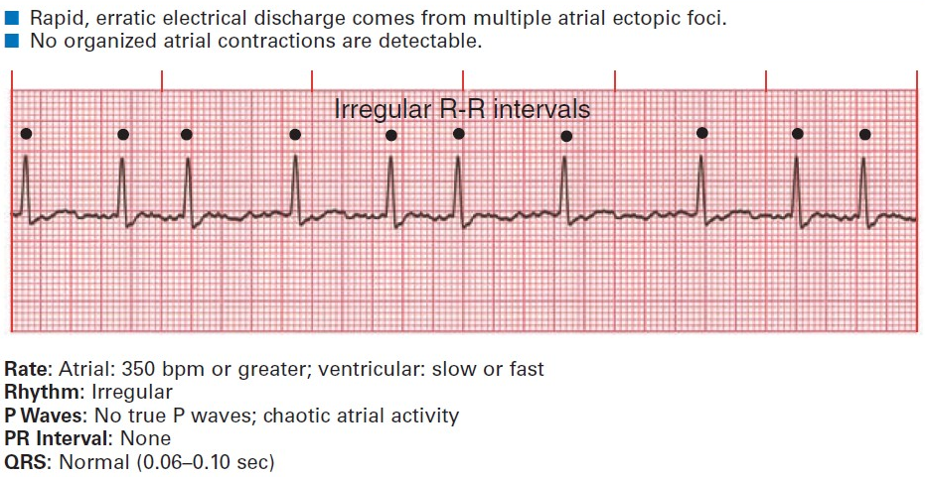
Atrial fibrillation (AF)

Slide 25
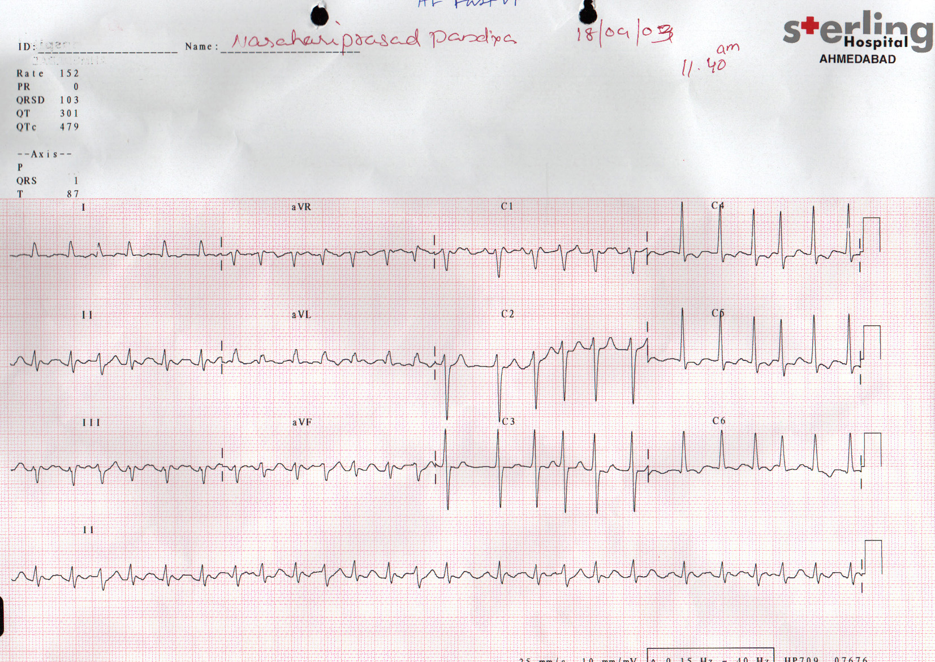
QRS width normal
No p wave
Irregular
HR: 160 b/m

Slide 26
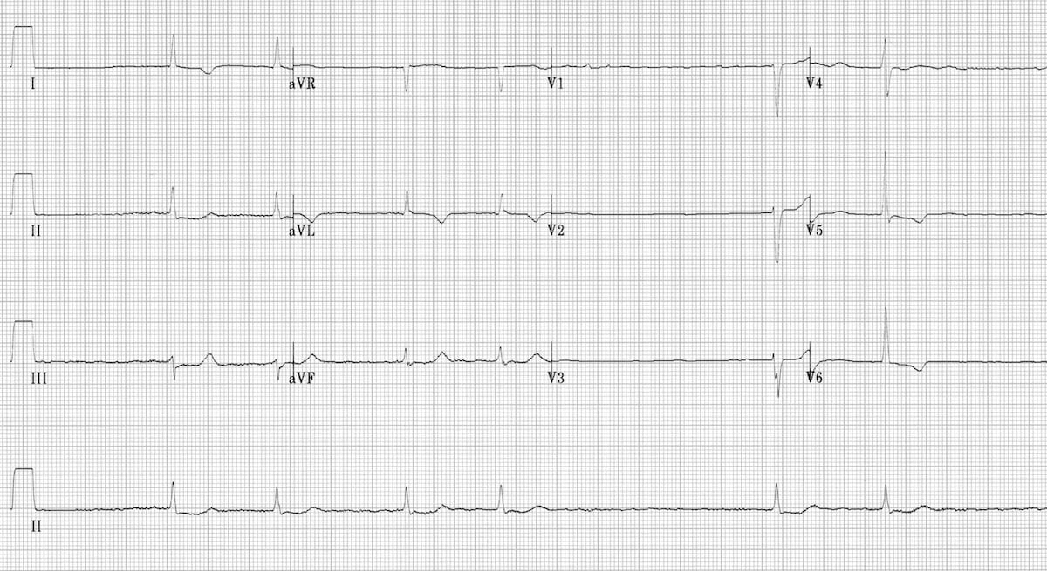
Slow Atrial Fibrillation
Irregular irregularity
Narrow QRS(normal)
No P waves
Rate 60 bpm

Slide 27
Supraventricular
Regular
Irregular
Supraventricular tachycardia (SVT)
Atrial fibrillation (AF)
Usually no P wave
No p wave but Fibrillary waves
Sinus tachycardia
Multifocal atrial tachycardia (MAT)
Usually with similar P wave
Usually with different shapes P wave
Atrial flutter
Atrial flutter
Saw teeth wave
Saw teeth wave
Multifocal atrial tachycardia (MAT)
Usually with different shapes P wave

Slide 28
Ventricular arrhythmias

Slide 29
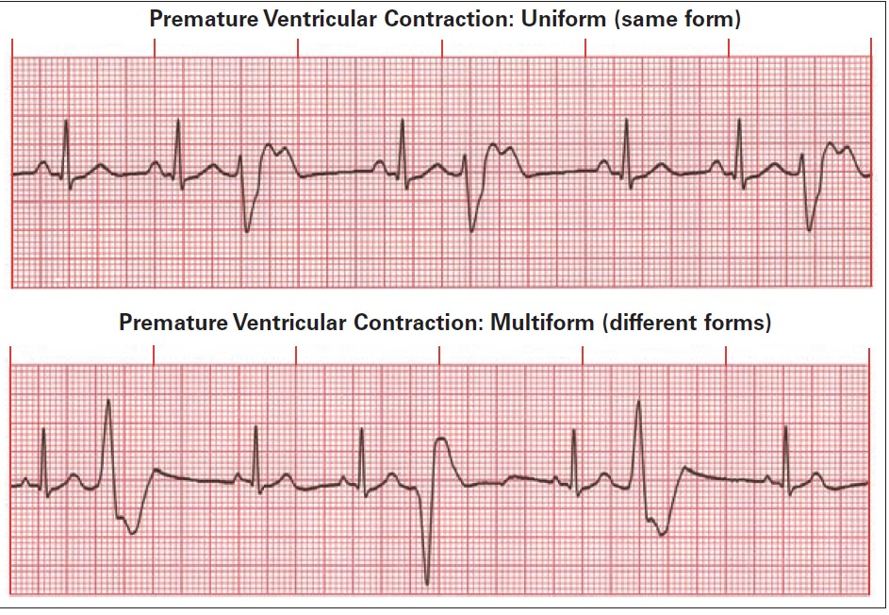
Premature ventricular contractions (PVCs)
ECG characteristics:
Premature.
QRS complex is abnormally wide
Secondary ST-T changes
No p wave.
Full compensatory pause often follows PVC

Slide 30
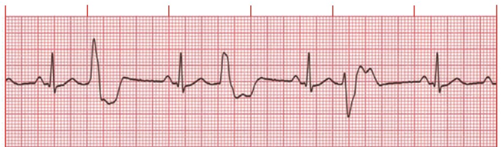
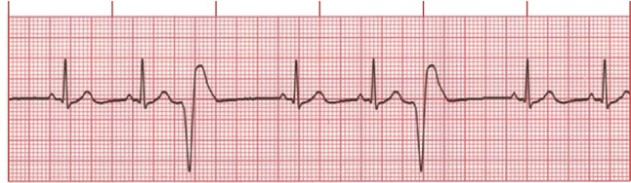
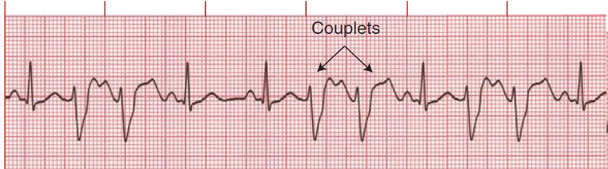
Bigeminy
Trigeminy
Couplets

Slide 31
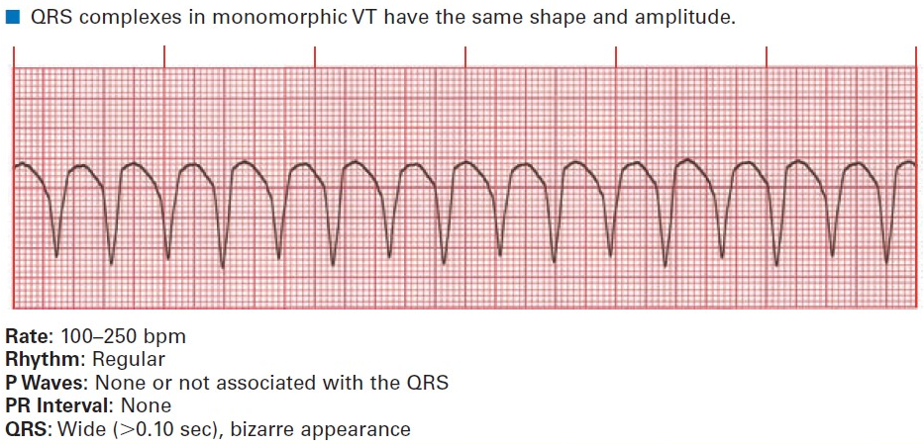
Ventricular tachycardia

Slide 32
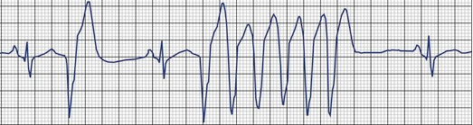
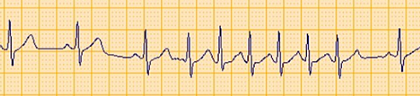
Three PVCs in succession
=
Ventricular tachycardia
Three PACs in succession
=
Supra ventricular (Atrial) tachycardia

Slide 33
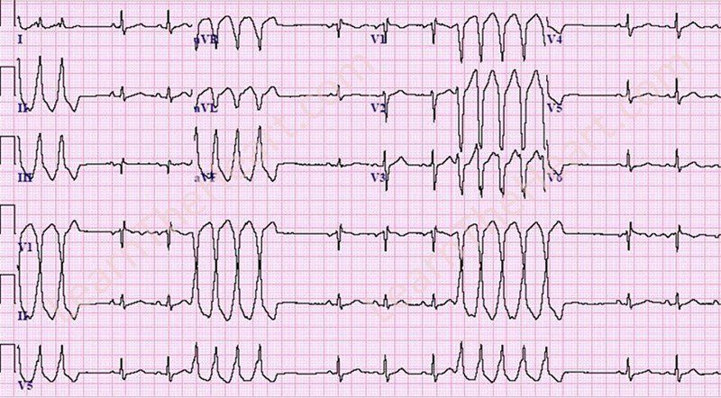
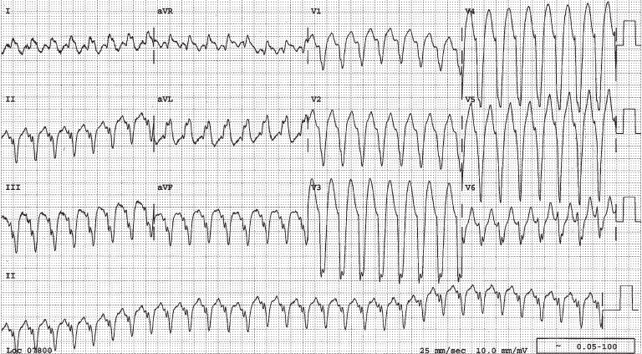
NON sustained VT
Sustained VT

Slide 34
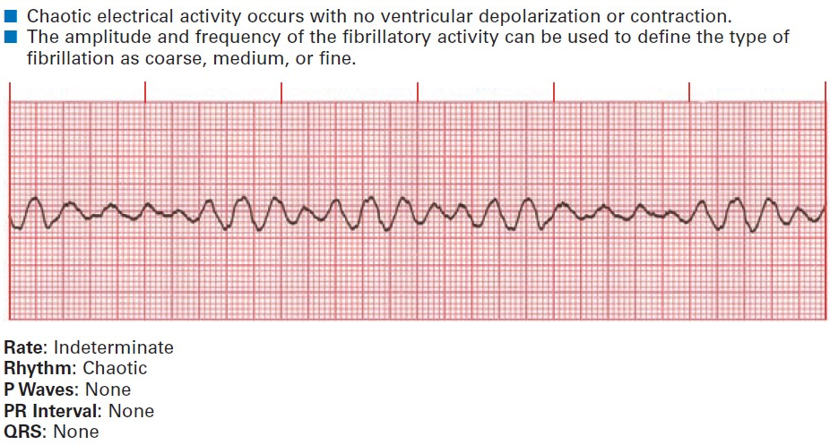
Ventricular Fibrillation
Causes:
IHD, electrolyte disturbances
Presentation:
?

Slide 35
Heart block
First degree HB
2nd degree heart block
3rd degree heart block

Slide 36
WPW syndrome
Short PR interval
Delta wave

